Slide 1

Use Particle Swarm Optimization via MATLAB: Engineering Case Studies
Professor Bo Liu
James Watt School of Engineering

Slide 2
Design of a PID controller
Proportional – Integral – Derivative (PID) control is widely used:
Controlling the temperature of a component
Controlling the elevation of a lift
Controlling the flight altitude and speed of unmanned aerial vehicle
Problem description
System output
Input of controller
Output of controller
r(t)
e(t)
u(t)
y(t)
PID
Controlled object
Given error by the user
e(t)=r(t)-y(t)

Slide 3
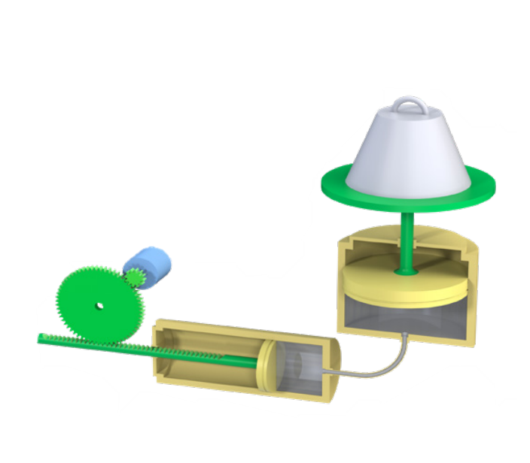
Hydraulic lift

Slide 4
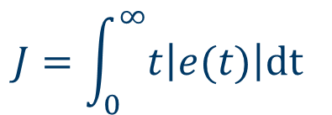
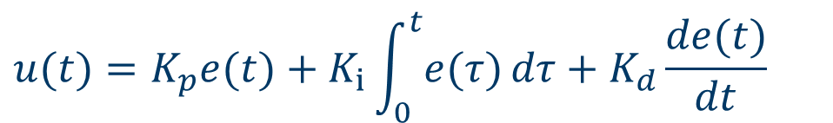
Design of a PID controller
Design requirement:
Minimize total error of control system
$$u(t)=K_{p}e(t)+K_{i}\int_{0}^{t}{e(τ)}dτ+K_{d}\frac{de(t)}{dt}$$
r(t)
e(t)
u(t)
y(t)
PID
Controlled object
Determined by PID
e(t)=r(t)-y(t)
J(K_{p}, K_{i}, K_{d})
is the control
objective.
$$J=\int_{0}^{∞}{t\left|e(t)\right|\text{dt}}$$
Integral of error in t period

Slide 5
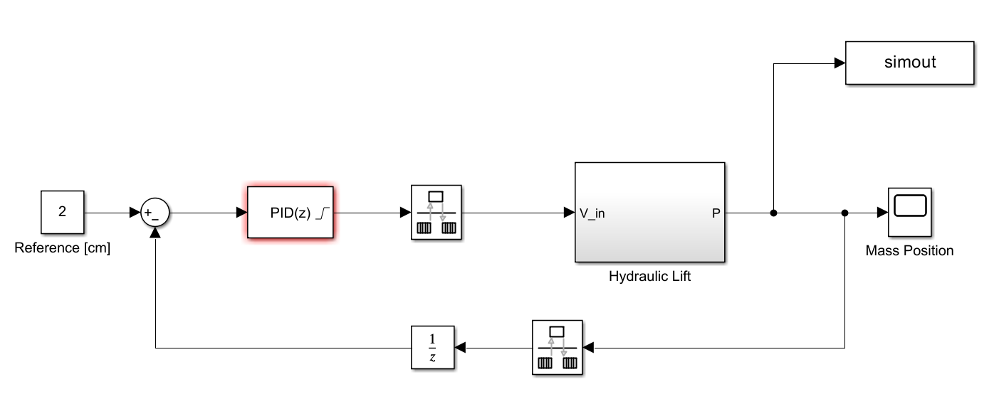
Design of a PID controller
The control system is built in Simulink (Hydraulic lift)

Slide 6
Design of a PID controller
Optimization problem formulation
minimize J(x)
x=[K_{p}, K_{i}, K_{d}]
K_{p} ∈[20 80]
K_{i} ∈[1 5]
K_{d} ∈[1 100]

Slide 7
Use PSO to find the optimal control parameters
Objective function in MATLAB
function [z] = PSO_PID(x)
% % Load the Simulink model and set the PID gains
load_system('Lift_PID');
assignin('base','Kp',x(1)); % Control parameter 1
assignin('base','Ki',x(2)); % Control parameter 2
assignin('base','Kd',x(3)); % Control parameter 3
out = sim('Lift_PID',[0,20]); % simulate the controller and the response is saved in info
info=stepinfo(simout.data);
disp(x)
z = 0.001*(info.RiseTime)+0.0006*(info.SettlingTime)+info.Overshoot+20*(abs(2-simout.Data(end))); % objective function to be minimized
%Weight coefficients in front of parameters are empirical
%the desired steady state is 2
end
See live script

Slide 8
Use PSO to find the optimal control parameters
Perform PSO for finding the optimal x and objective function value
options = optimoptions('particleswarm','PlotFcn',@pswplotbestf,...
'SwarmSize',10,MaxIterations=20,UseParallel=false);
lb = [20 1 1];
ub = [80 5 100];
rng default
nvars = 3;
tic
[x, fval] = particleswarm (@PSO_PID,nvars,lb,ub,options)
toc

Slide 9
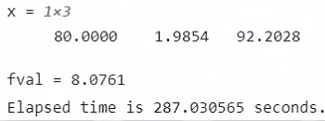
Use PSO to find the optimal control parameters
Optimization process
See live script

Slide 10
Use PSO to find the optimal control parameters
Perform PSO for finding the optimal x, objective function value and parallel computing
options = optimoptions('particleswarm','PlotFcn',@pswplotbestf,...
'SwarmSize',10,MaxIterations=20,UseParallel=true);
lb = [20 1 1];
ub = [80 5 100];
rng default
nvars = 3;
tic
[x, fval] = particleswarm (@PSO_PID,nvars,lb,ub,options)
toc
Parallel

Slide 11
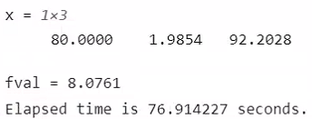
Use PSO to find the optimal control parameters
Optimization process
See live script

Slide 12




Thanks!
#UofGWorldChangers
@UofGlasgow

